Slide 1
Adaptive Faceted Browsing in Job Offers
Danielle H. Lee
02-20-2008

Slide 2
Research Motivation
Web application should cope with different user requirements and accessing devices
Insufficient navigation and orientation support in “too large” hyperspace can cause that users loose track of their position and increase recursion rate of navigation.
Faceted browsing
Does not address individual users’ needs
Fails to facilitate quick understanding of the size and content of the information domain
Does not lead to popular topics

Slide 3
Adaptive Faceted Navigation
A part of NAZOU project
Enhanced faceted browser with support for user adaptation based on an automatically acquired user model
In this job search app, the tools evaluating the relevance of individual search results by means of concept comparison with the user model is employed to show the suitability of a job offer.
Dynamic facet and restriction (sub-directory) display through user models

Slide 4
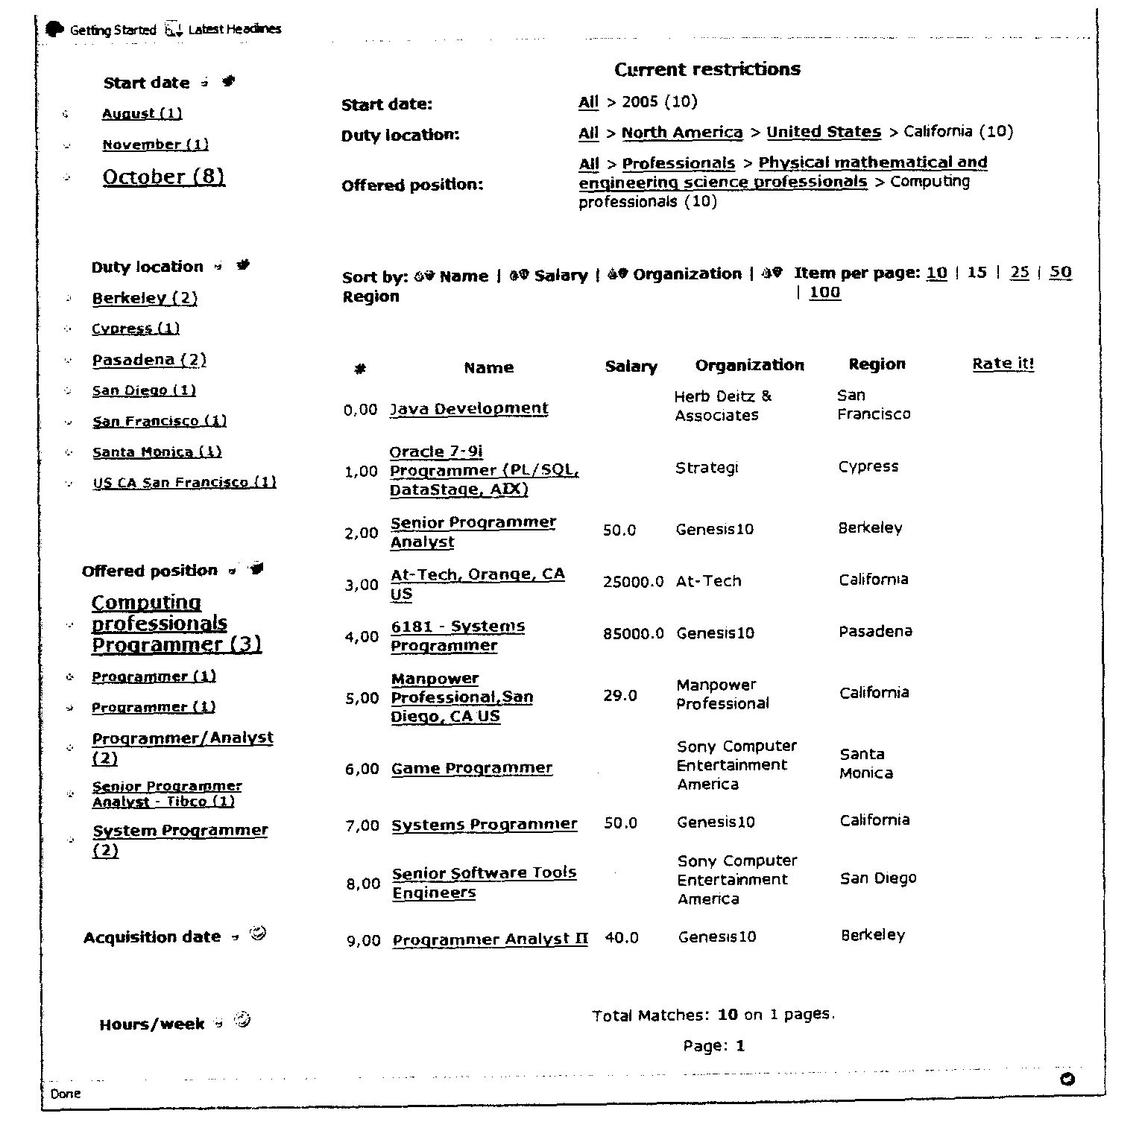
Interface of Adaptive Faceted Navigation

Slide 5
Facet Adaptation
To adapt to the specific needs of individual users at real time, the relevance of facets and restrictions is calculated based on
the in-session user behavior (i.e., user clicks)
the user model
global statistics (i.e., all user models)

Slide 6
Method of Adaptive Faceted Navigation
Especially, to calculate the relevance between facets and restriction and similarity among users, ontology was used.
Facet & Restriction Relevance
In-session User Behavior
(through log events)
User Model
User
Similarity
Model
Global
Relevance
In-session User Behavior
& User Model

Slide 7
Successive Adaption Process
Facet Ordering: All facets are ordered in descending order based on their relevance
Facet and Restriction Annotation: Active facets are annotated with the number of instances satisfying each restriction
Facet Restriction Recommendation: The most relevant restriction is a facet are marked as recommended.

Slide 8
Adaptive Facet Browsing for Job offers
Adaptive Views: Several visualization options – simple, extended or detailed view.
Information Overload Prevention
Query Refinement
Orientation Support
Guidance Support
Social Navigation and Recommendation
Visual Navigation and Presentation

Slide 9
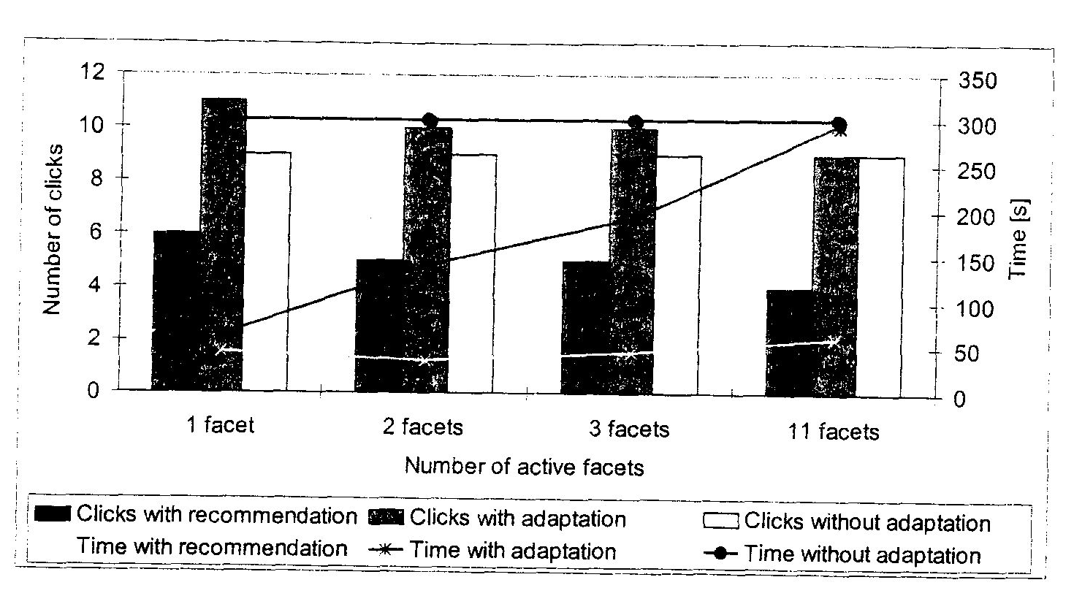
User Evaluation
Decrease required time and refresh time but increase number of clicks

Slide 10
Conclusion
Adaptively changing facets and restriction
The relevance of users’ logged data (clickstream) is calculated by ontology
Various recommendation techniques are used in a system - data mining, social navigation, and implicit preferences
They didn’t sufficient user study yet
The base data, especially the feasibility of the clickstream is questionable and insufficient to calculate accurate recommendations
Inaccurate relevance calculation can increase the recursion rate.

Slide 11
Thank you & Question?

